Slide 1

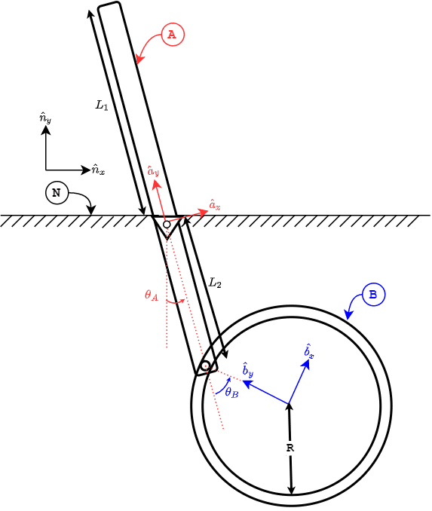
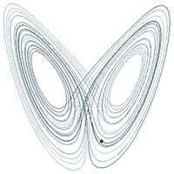
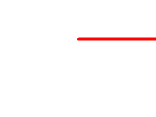
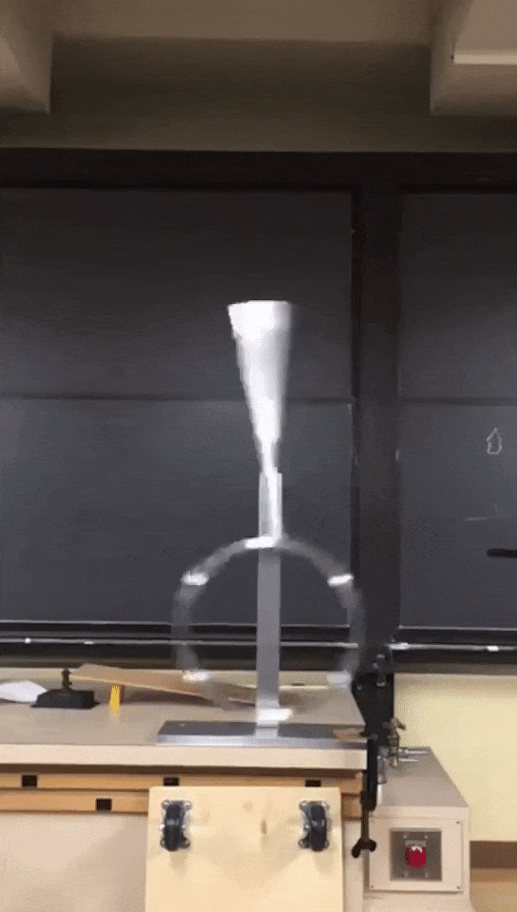
Team 7 - Nico and Anish
Chaotic double pendulum
-finding beauty in chaos
Question:
Simulate the trajectory of the center of mass of ring B, given some initial perturbation to the system
N_{o} , A_{o}
Lorenz Attractor-Wikipedia
Double rod pendulum-Wikipedia
B_{cm}
GIF credits- LinkedIn
Notes:
Model: The figure shows a double pendulum modeled as two rigid bodies A & B in Newtonian frame N. The relevant force on the two body system is considered to be gravity alone (all other forces are neglected for the purpose of this simulation). A is joined to N with a revolute joint at N_{o}, and B is joined to A using a prismatic joint.
Identifiers:
Relevant unit vectors.
Newtonian Frame N: N_{o}, <nx, <ny, <nz (orthogonal)
Rigid Frame A: A_{o}, <ax, <ay, <az
Rigid Frame B: Bcm, <bx, <by, <bz
Note: A_{o} is co-located with N_{o}. Bcm is the center of mass of B.
Include a table of scalar identifiers here.
Quantity/Symbol/Type/Value
Mass of the rod (A)/m_{A}/Constant/TBD
Moment of inertia of the rod A/I_{A}/Constant/TBD
Length of rod from A_{o} to the free end/L₁/Constant/TBD
Length of rod from A_{o} to the prismatic joint/L₂/Constant/TBD
Mass of the ring (B)/m_{B}/Constant/TBD
Moment of inertia of the ring (B)/I_{B}/Constant/TBD
Radius of the ring (B)/R/Constant/TBD
Angle between <nx and <ax in the positive <nx(=<ax) sense/ϴ_{A}/Variable
Angle between <ax and <bx in the positive <ax(=<bx) sense/ϴ_{B}/Variable
Ensure you know what variables you need to solve for!
ϴ_{A} & ϴ_{B} , thereby tracing < ^{No}r^{Bcm}

